Slide 1
Sleep Cycle & Lifestyle Analysis
By Sameer Prajapati

Slide 2
Description
This analysis aims to explore the intricate relationship between individuals' sleep patterns and their lifestyle factors using a structured dataset. The objective is to uncover trends and associations that influence the quality and duration of sleep, which plays a crucial role in overall health and well-being.

Slide 3
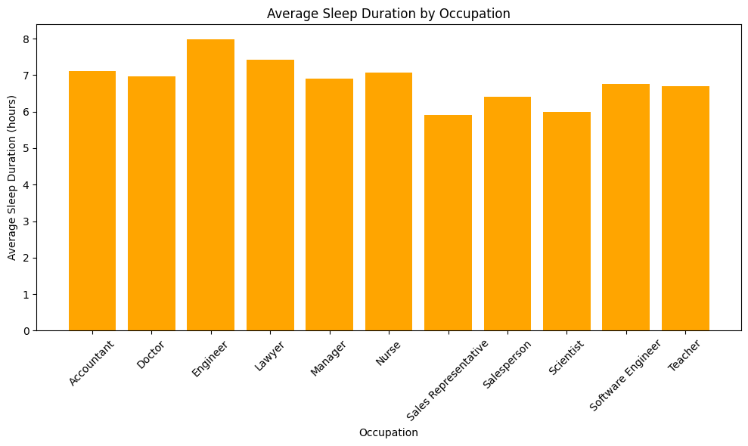
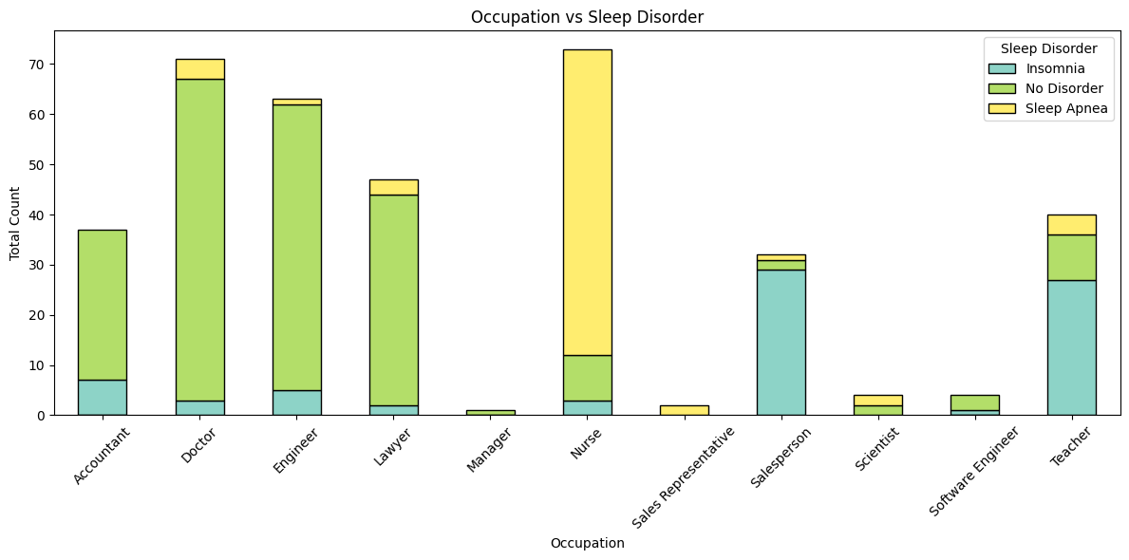
Visualizations
This bar chart compares the mean sleep duration across different job roles. Occupations with irregular or stressful hours (e.g., healthcare, students) generally show reduced sleep duration compared to others like freelancers or remote workers.
This stacked bar chart represents the distribution of sleep disorders across different occupations. The bars are broken down into three categories:
Insomnia (light blue)
No Disorder (green)
Sleep Apnea (yellow)

Slide 4
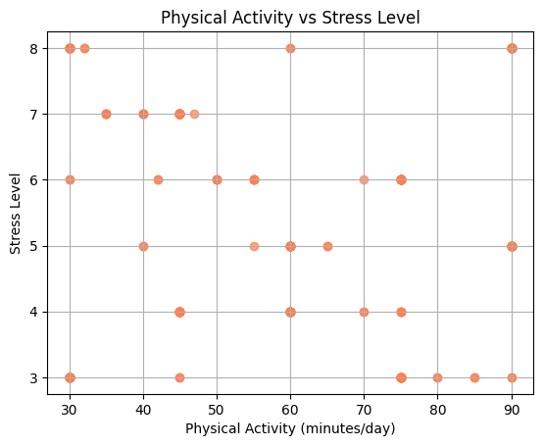
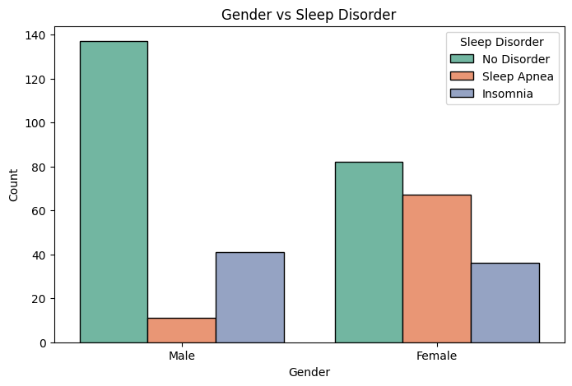
This scatter plot shows an inverse relationship between physical activity and stress. As physical activity increases, stress levels generally decrease, indicating the positive mental health benefits of regular exercise.
This bar chart compares sleep disorders between males and females.
Males mostly report no disorder, with fewer cases of insomnia or sleep apnea.
Females, however, show higher occurrences of sleep apnea and insomnia, suggesting gender-based differences in sleep health.

Slide 5
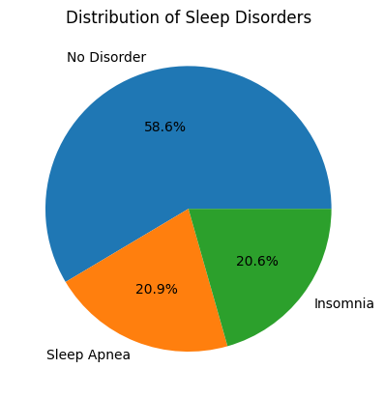
This pie chart illustrates the proportion of individuals with and without sleep disorders in the dataset:
58.6% of people have no sleep disorder, representing the majority.
20.9% suffer from sleep apnea, a breathing-related disorder.
20.6% report insomnia, a condition marked by difficulty falling or staying asleep.
This chart gives a quick overview of how common sleep-related issues are and highlights that over 40% of the population faces some form of sleep disturbance.

Slide 6
Conclusion
In conclusion, this analysis has revealed important patterns and correlations between sleep health and various lifestyle factors.
From physical activity and stress levels to occupation, gender, and BMI, it's clear that how we live directly affects how well we sleep. Individuals with higher physical activity and lower stress generally enjoy better sleep quality, while irregular work hours, high BMI, or psychological stress tend to increase the risk of disorders like insomnia and sleep apnea.
More than 40% of individuals in our dataset experience some form of sleep disorder, highlighting a growing concern that requires attention—not just medically, but also socially and behaviorally.
Key Information:
Active lifestyles promote better sleep.
Stress and sleep are deeply interconnected.
Occupation and gender influence sleep health patterns.
Thank you

